Slide 1
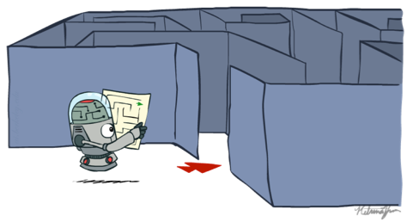
Artificial Intelligence
Ch3: Problem Solving by Search
Part 2
Instructor: Dr. Iyad Husni Alshami
[These slides adopted from Dan Klein and Pieter Abbeel at UC Berkeley ai.berkeley.edu]
Notes:
[These slides adopted from Dan Klein and Pieter Abbeel at UC Berkeley ai.berkeley.edu]
Build agents that plans ahead. Act rationally.

Slide 2
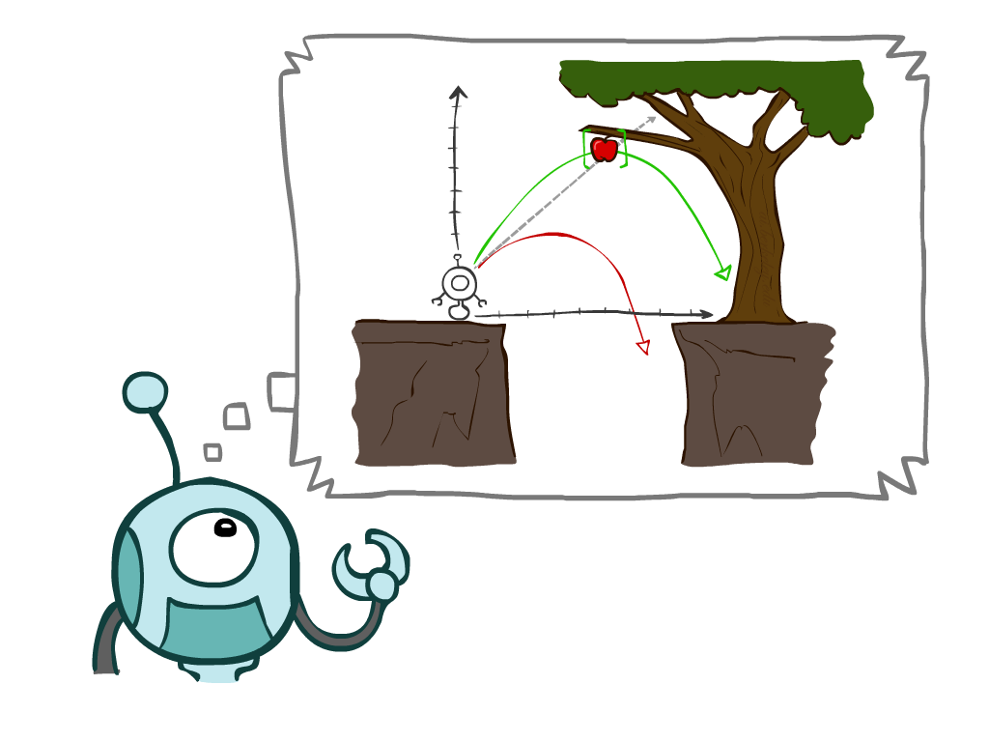
Chapter Outline
3.1 Problem-Solving Agents
3.2 Example Problems
3.3 Search Algorithms
3.4 Uninformed Search Strategies
Depth-First Search
Breadth-First Search
Uniform-Cost Search
3.5 Informed (Heuristic) Search Strategies
3.6 Heuristic Functions
Notes:
Many you have seen before.
General theme in the class:
A goal we have in mind.
A mathematical abstraction to formalize this
Algorithms that operate on these abstractions
Unified formalism leading to A* search (search guided by heuristic)

Slide 3
3.3. Search Algorithms

Slide 4
Searching for Solutions
A search algorithm takes a search problem as input and returns a solution, or an indication of failure.
A solution is an action sequence, so search algorithms work by considering various possible action sequences.
Finding out a solution is done by searching through the state space.
All problems are transformed as a search tree, generated by the initial state and successor function.
Notes:
~30 minutes
Solving only uses state space, successor, etc. Not power pellets, dots, etc.

Slide 5
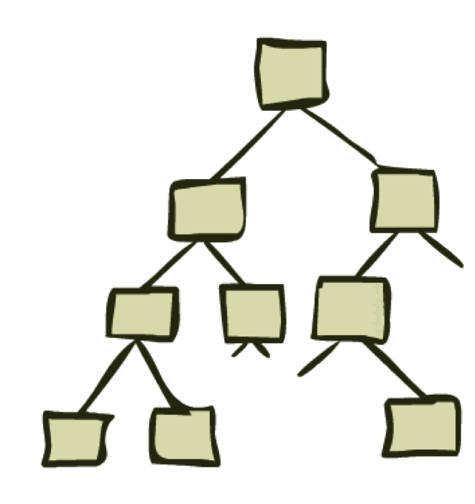
Search Tree
Initial state
The root of the search tree is a search node
represent the initial state of the solution
Expanding
is applying successor function to the current state
thereby generating a new set of states
Leaf Nodes
the states having no successors
Fringe: Set of search nodes that have not been expanded yet.
Notes:
The possible action sequences starting at the initial state form a search tree with the initial state at the root; the branches are actions and the nodes correspond to states in the state space of the problem.

Slide 6
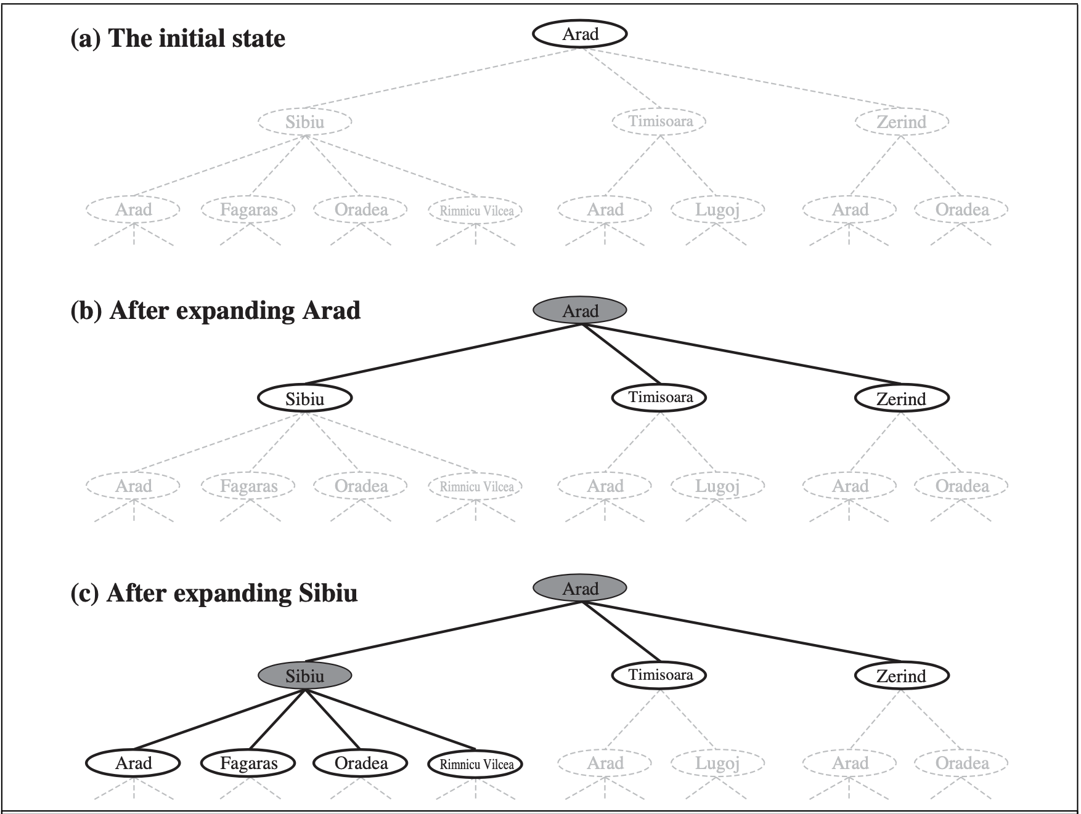
Tree Search
Example
The root node of the tree corresponds to the initial state, In(Arad). The first step is to test whether this is a goal state. (Clearly it is not, but it is important to check so that we can solve trick problems like “starting in Arad, get to Arad.”) Then we need to consider taking various actions. We do this by expanding the current state; that is, applying each legal action to the current state, thereby generating a new set of states. In this case, we add three branches from the parent node In(Arad) leading to three new child nodes: In(Sibiu), In(Timisoara), and In(Zerind). Now we must choose which of these three possibilities to consider further.

Slide 7
Search Tree
The set of all leaf nodes available for expansion at any
given point is called the frontier or open list.
The process of expanding nodes on the frontier continues until either a solution is found or there are no more states to expand.
Search strategy determines the choice of which state to expand next.
good choice → fewer work → faster
The essence of searching in case the first choice is not correct choosing one option and keep others for later inspection
Notes:
The possible action sequences starting at the initial state form a search tree with the initial state at the root; the branches are actions and the nodes correspond to states in the state space of the problem.

Slide 8
Search Tree
It is important to note that state space ≠ search tree
State Space has unique states {A, B}
while a search tree may have cyclic paths: A-B-A-B-A-B- …
A good search strategy should avoid such paths.

Slide 9
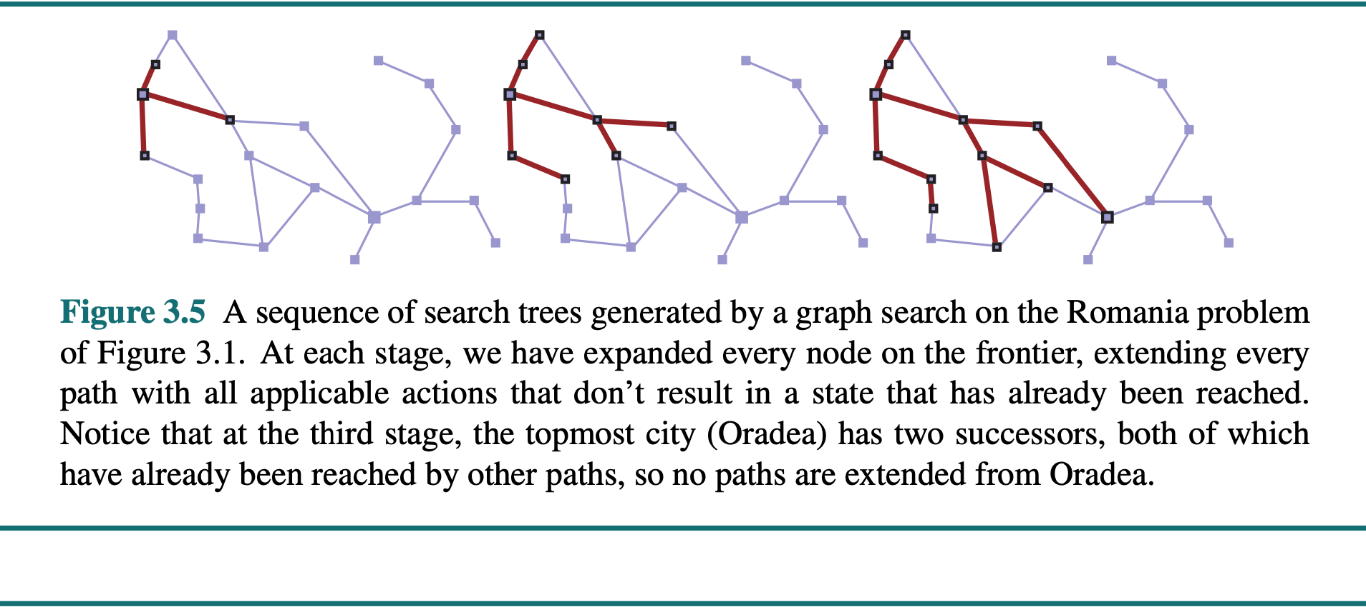
Search Tree & Search Graph

Slide 10
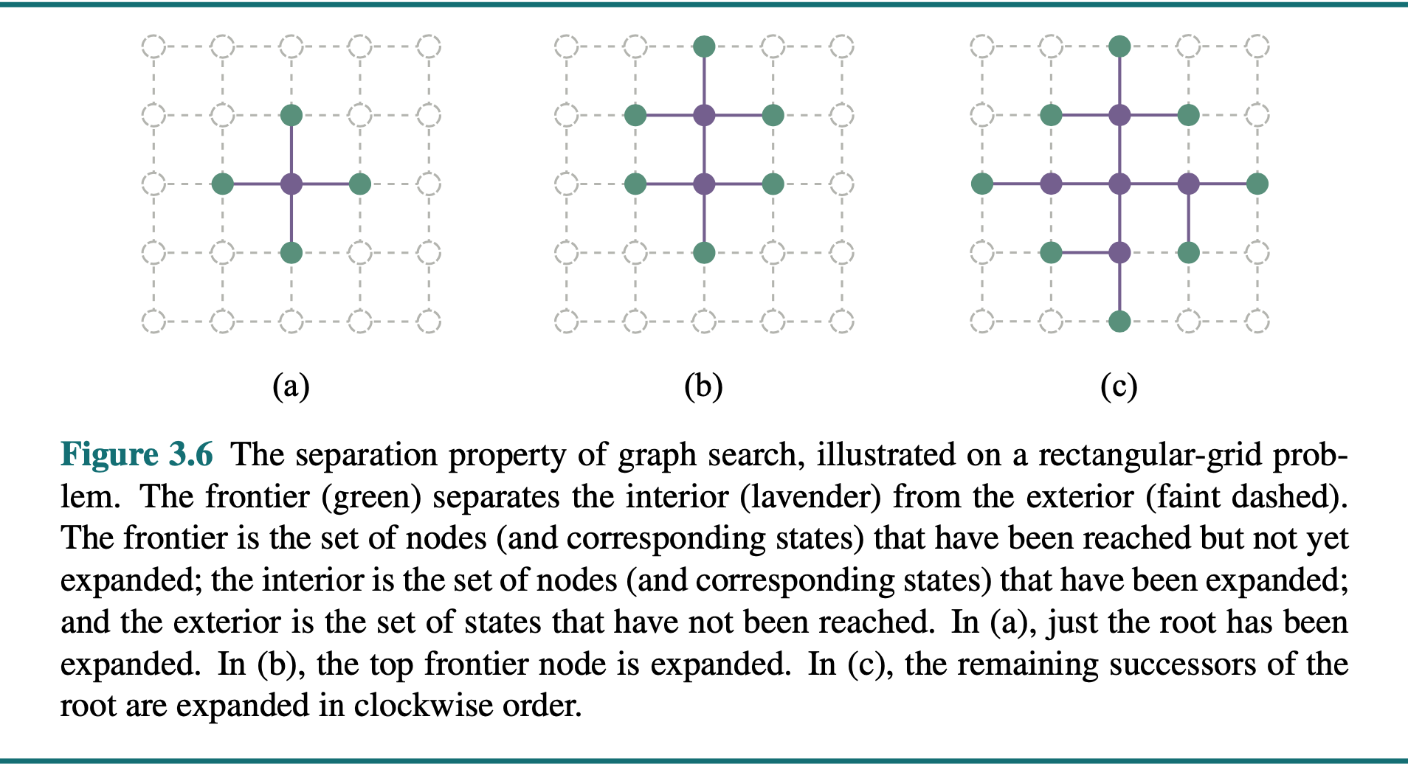
Search Tree & Search Graph

Slide 11
General Tree Search
Important ideas:
Fringe
Expansion
Exploration strategy
Main question: which fringe nodes to explore/expand?
Notes:
Pseudo-code. General algorithm. Some details specific to later topics, notably A*.
How do we decide which node from the frontier to expand next?

Slide 12
Best-First Search
How do we decide which node from the frontier to expand next?
A very general approach is called best-first search, in which we choose a node, n, with minimum value of some evaluation function, f (n).
On each iteration we choose a node on the frontier with minimum f(n) value,
return it if its state is a goal state, and otherwise apply EXPAND to generate child nodes.
Each child node is added to the frontier if it has not been reached before, or is re-added if it is now being reached with a path that has a lower path cost than any previous path.
The algorithm returns either an indication of failure, or a node that represents a path to a goal.
Notes:
By employing different f (n) functions, we get different specific algorithms, which this chapter will cover.

Slide 13
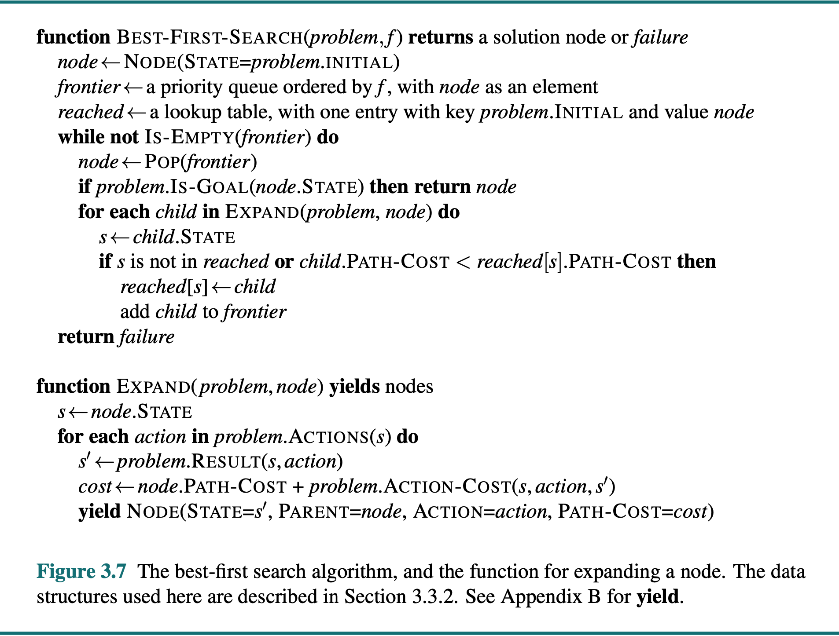
Best-First Search

Slide 14
Example: Tree Search
a
G
Initial State: S
Goal State: G
Successor Function: Shortest
b
c
e
d
e
d
f
f
S
h
strategy is arbitrary.
p
r
q
r
S
s
s → d
s → e
s → p
s → d → b
s → d → c
s → d → e
s → d → e → h
s → d → e → r
s → d → e → r → f
s → d → e → r → f → c
s → d → e → r → f → G
d
e
p
b
c
e
h
r
q
a
a
h
r
p
q
f
p
q
f
q
c
G
q
c
G
a
a
Notes:
For example, strategy is arbitrary.
S D E R F G
Don’t return until G removed. Not when G added. Important later.
188-guided-search; in general we don’t have 188 on call to tell us what to expand next

Slide 15
Infrastructure for Search Algorithms
Search algorithms require a data structure to keep track of the search tree that is being constructed. For each node n of the tree, the structure contains four components:
n.STATE: which state it is in the state space
n.PARENT: from which node it is generated
n.ACTION: which action applied to its parent-node to generate it
n.PATH-COST: the cost, g(n), from initial state to the node n itself
DEPTH: number of steps along the path from the initial state

Slide 16
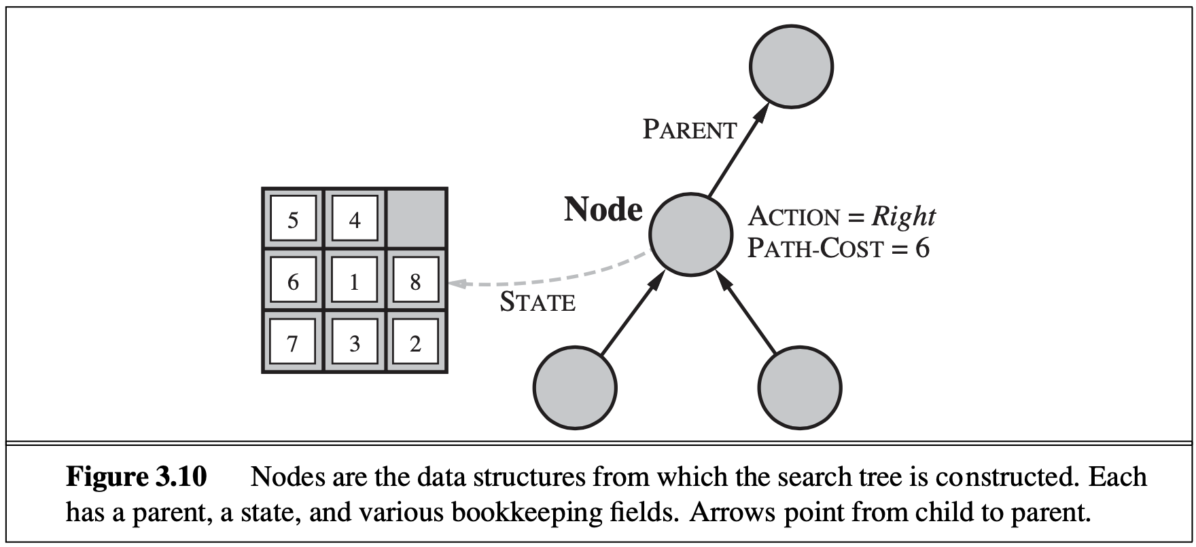
Infrastructure for Search Algorithms

Slide 17
Infrastructure for Search Algorithms
We need a data structure to store the frontier, the appropriate choice is a queue of some kind, because the operations on a frontier are:
IS-EMPTY(frontier) returns true only if there are no nodes in the frontier.
POP(frontier) removes the top node from the frontier and returns it.
TOP(frontier) returns (but does not remove) the top node of the frontier.
ADD(node, frontier) inserts node into its proper place in the queue.
Notes:
Three kinds of queues are used in search algorithms: • A PRIORITY queue first pops the node with the minimum cost according to some evaluation function, f . It is used in best-first search. • A FIFO queue or first-in-first-out queue first pops the node that was added to the queue first; we shall see it is used in breadth-first search.
• A LIFO queue or last-in-first-out queue (also known as a stack) pops first the most recently added node; we shall see it is used in depth-first search.
The reached states can be stored as a lookup table (e.g. a hash table) where each key is a state and each value is the node for that state.

Slide 18
Measuring Problem-Solving Performance
The performance of a search strategy/algorithm can be evaluated in four ways:
Completeness:
is the strategy guaranteed to find a solution when there is one?
Optimality:
does the strategy find the highest-quality solution when there are several different solutions?
Time Complexity:
how long does it take to find a solution?
Space Complexity:
how much memory is needed to perform the search?
Notes:
to be complete, a search algorithm must be systematic in the way it explores an infinite state space, making sure it can eventually reach any state that is connected to the initial state.

Slide 19
Measuring Problem-Solving Performance
In AI, Complexity is expressed in
b, branching factor, maximum number of successors of any node
d, the depth of the shallowest goal node.
depth of the least-cost solution
m, the maximum length of any path in the state space
Time and Space is measured in
number of nodes generated during the search
maximum number of nodes stored in memory

Slide 20
Measuring Problem-Solving Performance
For effectiveness of a search algorithm the total cost can be considered as:
The total cost = path cost (g) of the solution found + search cost
search cost = time necessary to find the solution
Tradeoff:
long time, optimal solution with least g.
vs.
shorter time, solution with slightly larger path cost g.

Slide 21
3.4 Uninformed Search Strategies

Slide 22
Uninformed Search Algorithm
An uninformed search algorithm is given no clue about how close a state is to the goal(s).
For example, consider our agent in Arad with the goal of reaching Bucharest. An uninformed agent with no knowledge of Romanian geography has no clue whether going to Zerind or Sibiu is a better first step.
In contrast, an informed agent (Section 3.5) who knows the location of each city knows that Sibiu is much closer to Bucharest and thus more likely to be on the shortest path.

Slide 23
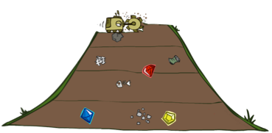
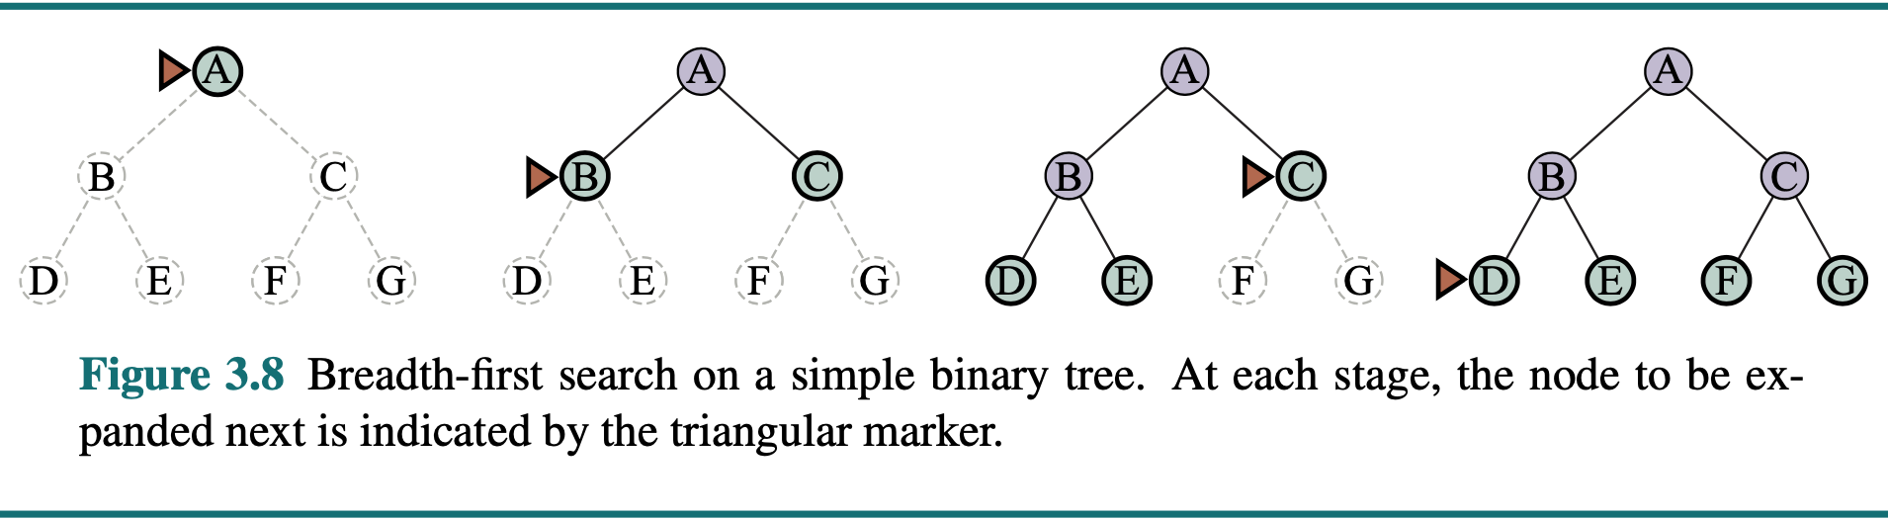
Breadth-First Search
Notes:
Another strategy. Layer by layer.
Strip-mining
BFS

Slide 24
DFS Search Algorithm Properties
Complete: Guaranteed to find a solution if one exists?
Optimal: Guaranteed to find the least cost path?
Time complexity?
Space complexity?
Cartoon of search tree:
b is the branching factor
d is the maximum depth
solutions at various depths
Number of nodes in entire tree?
1 + b + b² + …. b^{d} = O(b^{d})
1 node
b
…
b nodes
b² nodes
d tiers
b^{d} nodes
Notes:
Questions about search algoirthms.
Simple cartoony case – assume each node is state space connects to exactly b other nodes.
Since doing bound estimation, we’re correct as long as fewer than b.
Infinite?

Slide 25
Breadth-First Search
a
G
Strategy: expand a shallowest node first
Implementation: Fringe is a FIFO queue
b
c
d
e
f
S
h
p
q
r
S
d
e
p
Search
Tiers
b
c
e
h
r
q
a
a
h
r
p
q
f
p
q
f
q
c
G
q
c
G
a
a
Notes:
Same general algorithm. Shallowest node.
S D E P B C E H R Q

Slide 26
Breadth-First Search (BFS) Properties
What nodes does BFS expand?
Processes all nodes above shallowest solution
Let depth of shallowest solution be s
Search takes time O(b^{s})
How much space does the fringe take?
Has roughly the last tier, so O(b^{s})
Is it complete?
s must be finite if a solution exists
Is it optimal?
Only if costs are all 1 (more on costs later)
1 node
b
…
b nodes
s tiers
b² nodes
b^{s} nodes
b^{d} nodes
Notes:
Tier of best solution. If on right, b^s. Exponential Big.

Slide 27
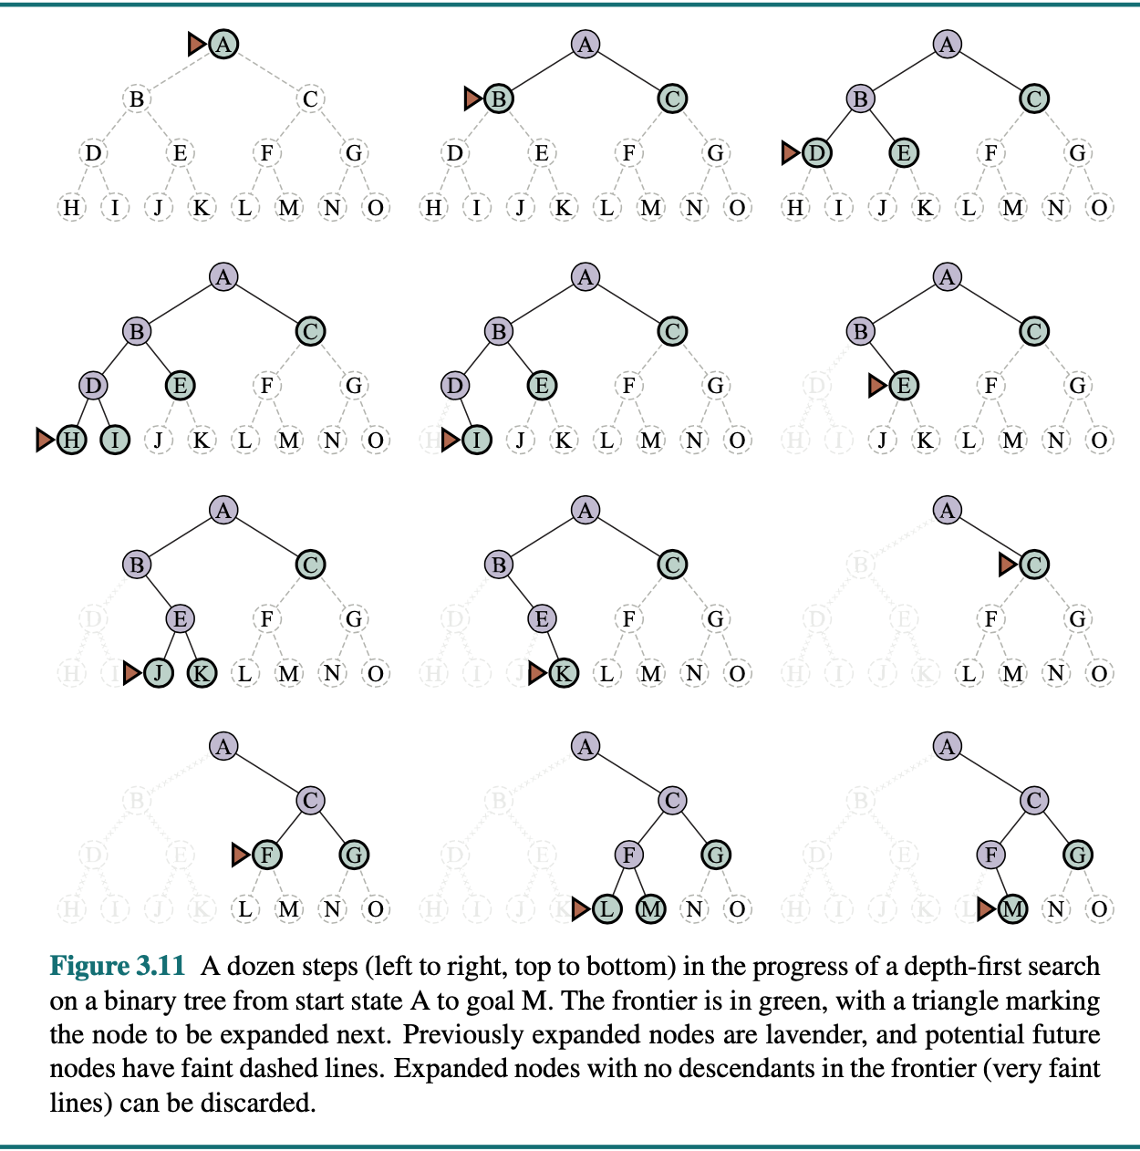
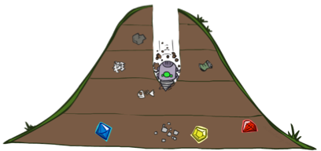
Depth-First Search
Notes:
That was generic. Now specific strategy – dfs
Go deep!
Exponentially large at the bottom.

Slide 28
Depth-First Search
a
G
a
c
b
c
Strategy: expand a deepest node first
Implementation: Fringe is a LIFO stack
b
e
d
e
d
f
f
S
h
h
p
p
r
q
r
q
S
d
e
p
b
c
e
h
r
q
a
a
h
r
p
q
f
p
q
f
q
c
G
q
c
G
a
a
Notes:
S D B A C A E H P Q
Ties alphabetically in this case.

Slide 29
Depth-First Search (DFS) Properties
What nodes DFS expand?
Some left prefix of the tree.
Could process the whole tree!
If m is finite, takes time O(b^{m})
How much space does the fringe take?
Only has siblings on path to root, so O(bm)
Is it complete?
m could be infinite, so only if we prevent cycles (more later)
Is it optimal?
No, it finds the “leftmost” solution, regardless of depth or cost
1 node
b
…
b nodes
b² nodes
m tiers
b^{m} nodes
Notes:
Process whole tree if goal is lower right.
Space: At each level, children of one node at most on fringe, so b. Times number of layers m. (Small!)

Slide 30

Video of Demo Maze Water
(BFS)
(DFS)
L2D6 – Boats in water. States light up first time explored. Which one?
Notes:
L2D6 – Boats in water. States light up first time explored. Which one?
Part1: Breadth
Part2: Depth - Leftmost not very good!

Slide 31
Iterative Deepening
Idea: get DFS’s space advantage with BFS’s time / shallow-solution advantages
Run a DFS with depth limit 1. If no solution…
Run a DFS with depth limit 2. If no solution…
Run a DFS with depth limit 3. …..
Isn’t that wastefully redundant?
Generally most work happens in the lowest level searched, so not so bad!
b
…
Notes:
Another strategy. Combine best of both.
DFS – successor says if deeper than one, stop.
Really common.

Slide 32
Cost-Sensitive Search
a
GOAL
2
2
b
c
3
2
1
8
2
e
d
f
3
9
8
2
START
h
1
4
2
p
4
r
15
q
BFS finds the shortest path in terms of number of actions.
It does not find the least-cost path. We will now cover a similar algorithm which does find the least-cost path.
How?
Notes:
“Cost Search” What if you have costs associated with arcs? Could you rewrite with what we already know?
Lowest number of actions S->e->r->f->G. Expensive!

Slide 33

Uniform Cost Search
Notes:
Unfortunate name. It’s a “cost search” that is uniform, not a uniform cost.
Instead of depth, go by cost. Cheap things first, even if multiple actions.

Slide 34
Uniform Cost Search
2
G
a
Strategy: expand a cheapest node first
Implementation: Fringe is a priority queue (priority: cumulative cost)
b
c
1
8
2
2
e
3
d
f
9
8
2
S
h
1
1
p
q
r
15
0
S
d
3
e
9
p
1
b
4
e
5
h
17
r
11
q
16
c
11
Cost contours
a
6
a
h
13
r
7
p
q
f
p
q
f
8
q
c
G
q
c
a
11
G
10
a
Notes:
Like breadth first, but with costs. Label with cumulative cost.
Goal path not victory until try to expanded.
Contours show equal cost.

Slide 35
Uniform Cost Search (UCS) Properties
What nodes does UCS expand?
Processes all nodes with cost less than cheapest solution!
If that solution costs C* and arcs cost at least ε , then the “effective depth” is roughly C*/ε
Takes time O(b^{C*/ε}) (exponential in effective depth)
How much space does the fringe take?
Has roughly the last tier, so O(b^{C*/ε})
Is it complete?
Assuming best solution has a finite cost and minimum arc cost is positive, yes!
Is it optimal?
Yes! (Proof next lecture via A*)
b
c ≤ 1
…
C*/ε “tiers”
c ≤ 2
c ≤ 3
Notes:
Let’s say C* is 10 and minimum step size is 2. How deep in the tree? C*/e = 5. How many nodes is that?

Slide 36
Uniform Cost Issues
Remember: UCS explores increasing cost contours
The good: UCS is complete and optimal!
The bad:
Explores options in every “direction”
No information about goal location
We’ll fix that soon!
…
c ≤ 1
c ≤ 2
c ≤ 3
Start
Goal
[Demo: empty grid UCS (L2D5)]
[Demo: maze with deep/shallow water DFS/BFS/UCS (L2D7)]
Notes:
What if you know the goal?

Slide 37
Video of Demo Empty UCS
Notes:
L2D5
Then L2D7, Breadth, Uniform, Depth

Slide 38
Video of Demo Maze with Deep/Shallow Water DFS, BFS, or UCS?
Video of Demo Maze with Deep/Shallow Water --- DFS, BFS, or UCS? (part 1)
Video of Demo Maze with Deep/Shallow Water --- DFS, BFS, or UCS? (part 2)
Video of Demo Maze with Deep/Shallow Water --- DFS, BFS, or UCS? (part 3)

Slide 39

The One Queue
All these search algorithms are the same except for fringe strategies
Conceptually, all fringes are priority queues (i.e. collections of nodes with attached priorities)
Practically, for DFS and BFS, you can avoid the log(n) overhead from an actual priority queue, by using stacks and queues
Can even code one implementation that takes a variable queuing object

Slide 40
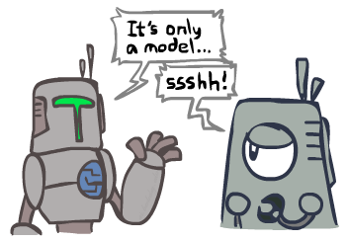
Search and Models
Search operates over models of the world
The agent doesn’t actually try all the plans out in the real world!
Planning is all “in simulation”
Your search is only as good as your models…
Notes:
All in your head.

Slide 41
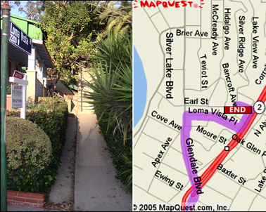
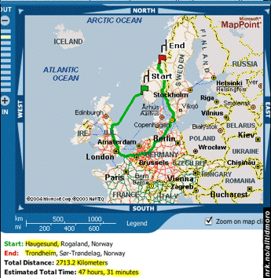

Search Gone Wrong?
Notes:
Next time – guided search where you know something about direction of solution.

